Slide 2
Kubernetes 1.14+
Vicki Cheung

Slide 3
Kubernetes 1.14
31 enhancements
10 moving to stable
12 in beta
7 net new
Themes
Supporting more workloads
Extensibility

Slide 4
Windows Support!
Windows Node support graduates to stable
Manage your Linux and Windows workloads with a single orchestrator
Supports:
Windows Server 2019 for worker nodes and containers
Out of tree networking with Azure-CNI, OVN-Kubernetes, and Flannel

Slide 5
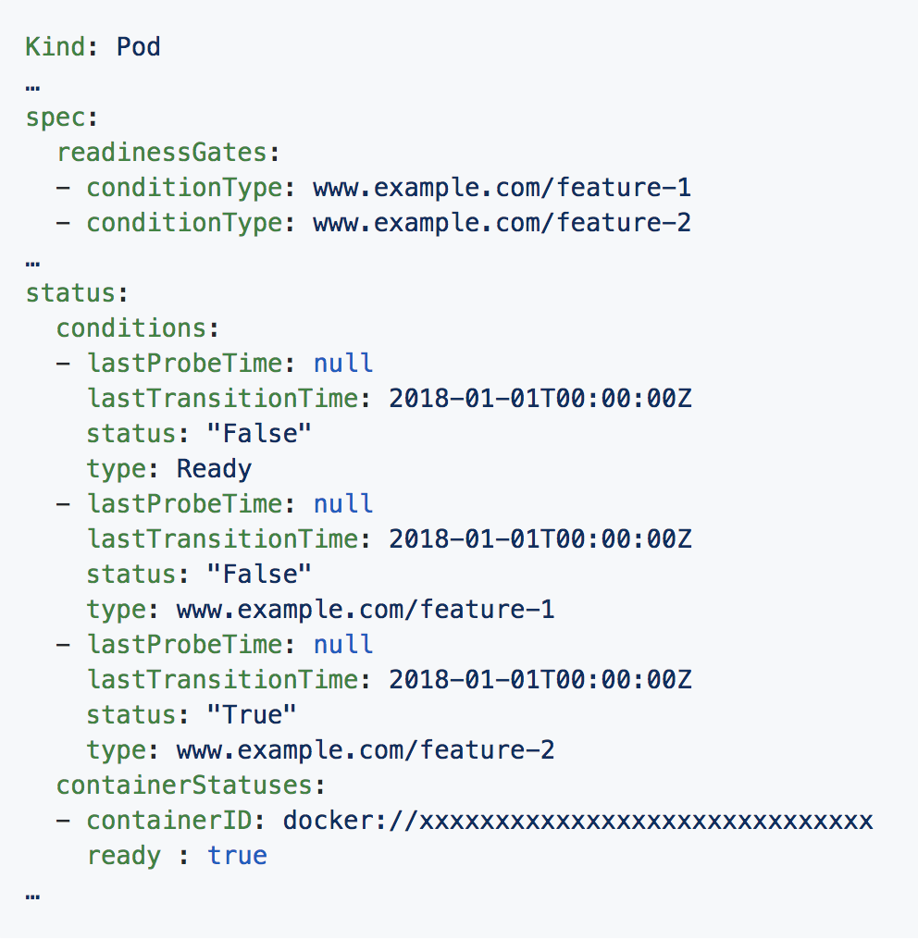
Pod Ready++
Allows custom external feedback on pod readiness
When “container is up and running” doesn’t
mean “ready to take traffic”
Helps prevent rolling updates from prematurely
terminating pods and causing service disruption
Notes:
because of other infrastructure dependencies, such as network policies and load balancers

Slide 6
Pod Priority & Preemption
Graduation to stable!
Improve resource utilization while ensuring critical workloads remain schedulable
Great for physical / fixed-sized clusters, or when you run out of cloud!
Notes:
because of other infrastructure dependencies, such as network policies and load balancers

Slide 7
Persistent Local Volumes
Graduation to stable!
Use local storage with the same Persistent Volume API, with scheduler awareness
Automatically format and mount the filesystem
High-performance distributed databases with StatefulSets

Slide 8
kubectl
kubectl plugin mechanism graduating to stable
Extend kubectl with custom subcommands
Great for packaging and distributing custom functionality to your users
Kustomize integration
Use the `-k` flag or the `kustomize` subcommand
Customize and patch Kubernetes resource files without templates

Slide 9
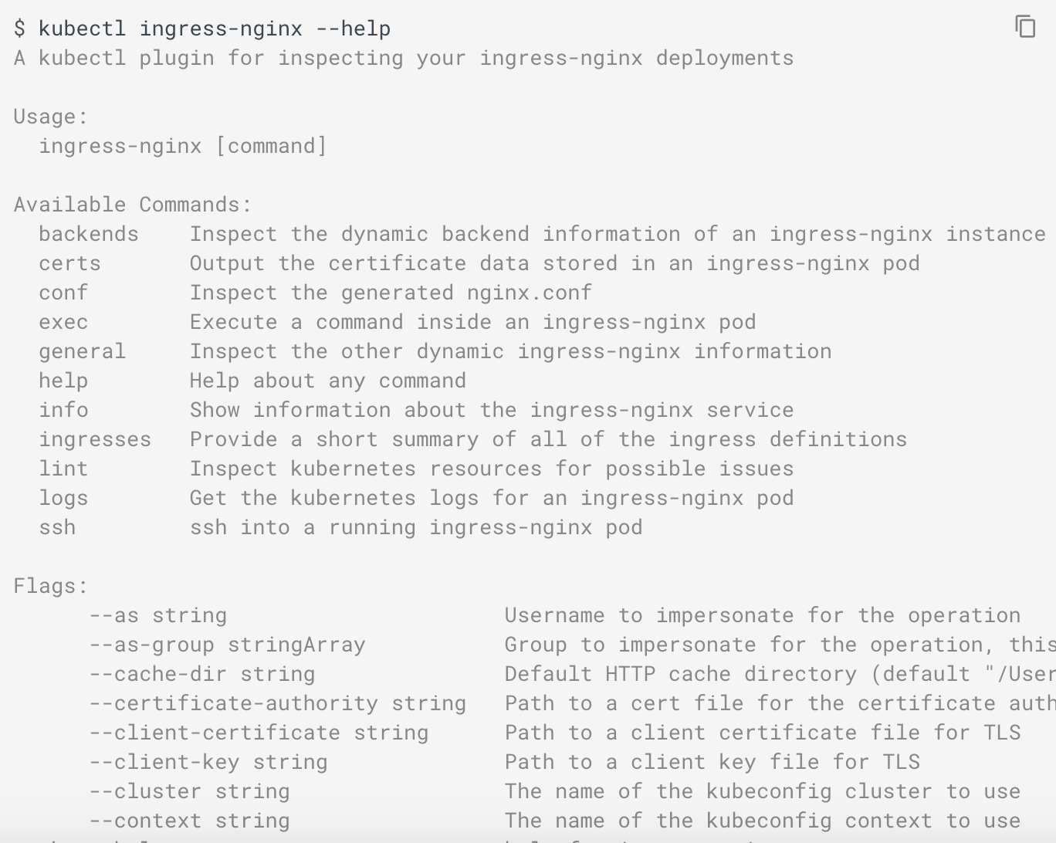
kubectl

Slide 10
Kubernetes 1.15
25 enhancements
2 moving to stable
13 in beta
10 in alpha
Themes
Continuous improvement for stability and project maturity
Extensibility

Slide 11
Kubernetes 1.15
CRDs
Pruning and defaulting
OpenAPI publishing
Cluster Lifecycle
kubeadm promoted high availability (HA) capability to beta
kubeadm rotates all your certificates (on upgrades) before they expire
CSI
Specify another PVC as a "DataSource" so the new volume becomes a clone of the source volume

